Slide 1
Low-Fi Prototyping
Kendall Costello, Tina Jiang, Andrea Shulman, Steve Weyns
Notes:
Hello everyone, I’m Kendall, and today I will be presenting on the work my team has done in terms of creating our low-fi prototype.

Slide 2

Mission Statement
Selected Interface
Low-fi prototype
Three task flows
Experiment
Method and Results
UI Changes + Summary
Notes:
So over this past week my team has worked endlessly to brainstorm possible design ideas, storyboard possible scenarios, and build possible prototypes all in a attempt to encapsulate the journaling experience. But what exactly do we mean when we say a journaling experience? Well, if you look at this picture, you can see what journalers typically value, that is, an experience that’s elegant, aesthetic, and overall, just clean in nature. While there have existed plenty of journaling apps overcomplicate the process as opposed to focusing on the importance of simplicity. So my team set out to create a journaling experience which encapsulates the alternative

Slide 3
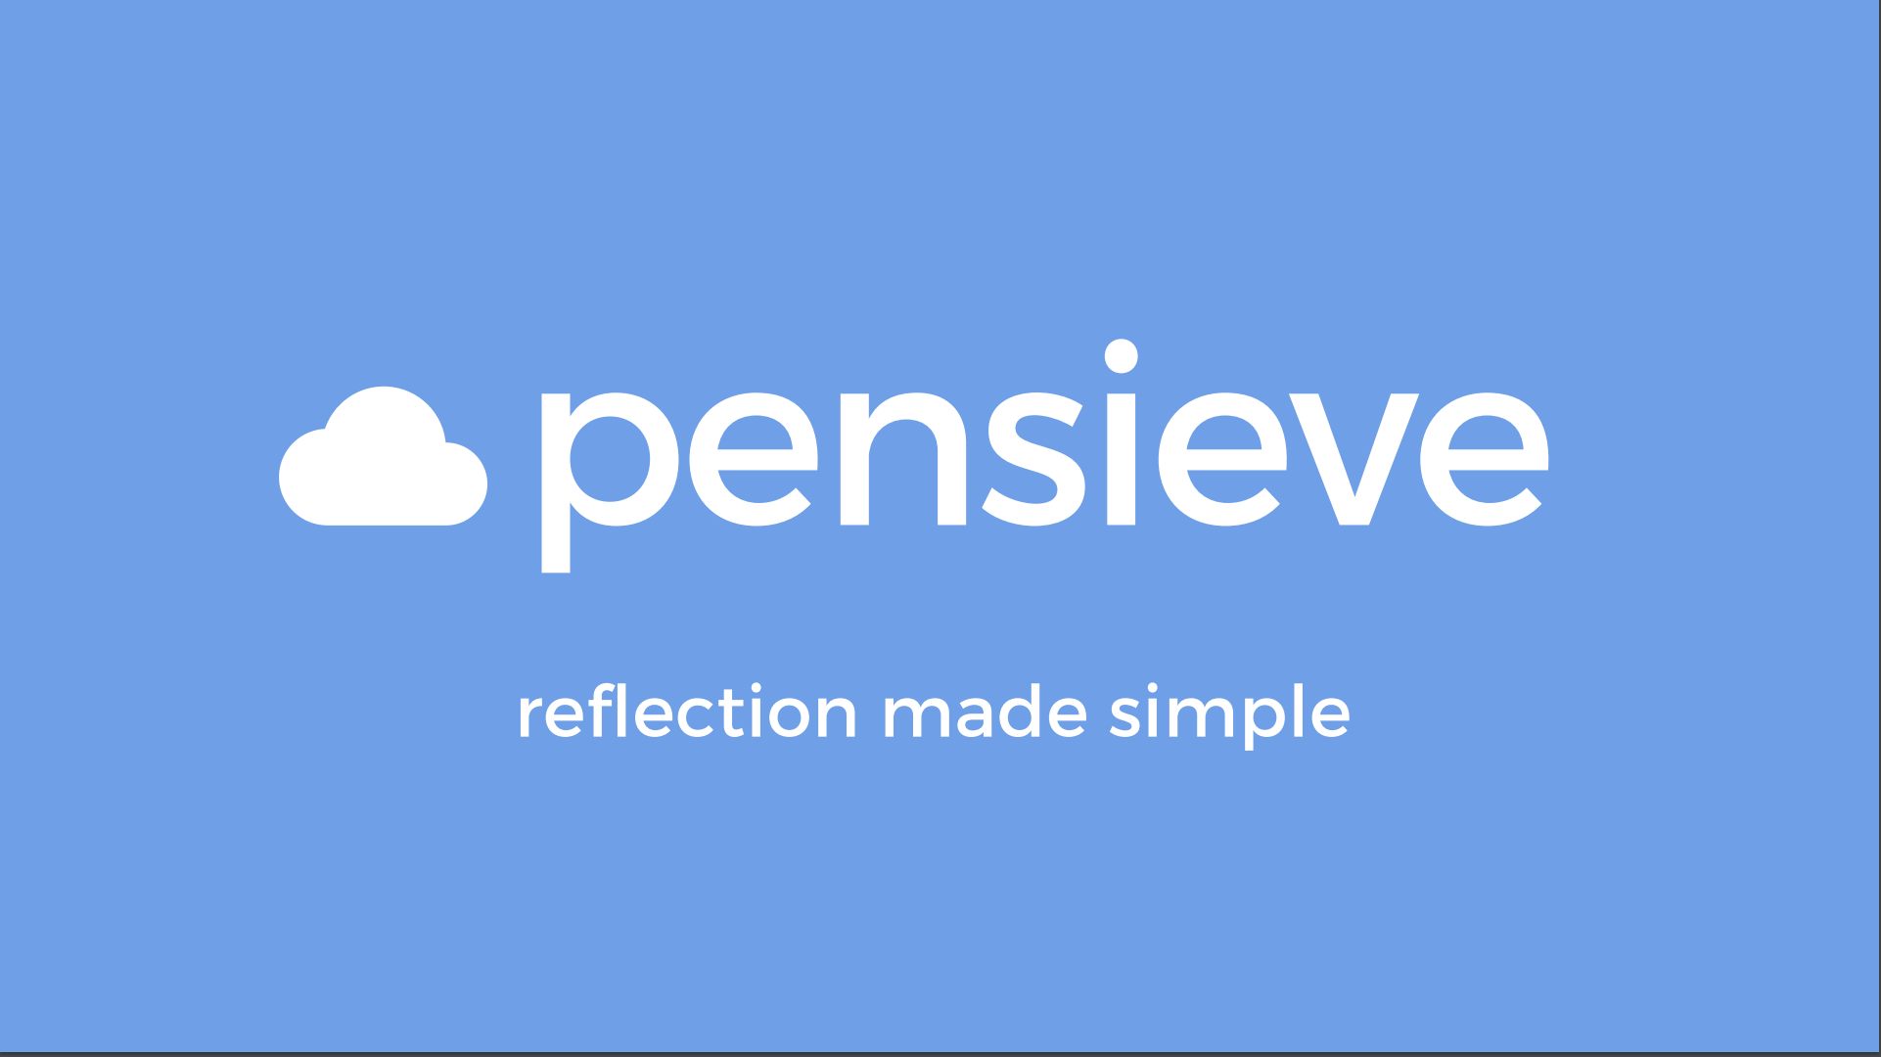
Notes:
We are pensieve, and our value proposition is to make reflection simple. Our idea is not to over-complicate the interface, but rather, to allow the user maximum free will in deciding how they wish to express their reflective experience.

Slide 4
Mission Statement
Notes:
As for our mission statement, we want to

Slide 5
Empower people to consistently record and reflect on their memories
Notes:
So, we hope to empower people to consistently record and reflect on their memories. As Tina and Andrea mentioned in their presentations, many of the people we interviewed expressed this key desire to cement a habit of reflection, and we hope to do just that.

Slide 6
Interface
Notes:
As for the interface we chose, we went through an intense brainstorming session where we came up with ideas as diverse as a strictly speech interface to a virtual reality build-a-memory gaming experience, but what we essentially ended up choosing was our initial blank slate idea, where we want to create an iOS gestural blank slate experience.

Slide 7
Reasoning
Most simplistic
Reduces friction for the user
More conducive to active recording
Provides more malleability
Infinite space (zoom in and out) represents thought structure
Streaks encourage consistency
Streamlined organization
Notes:
Why did we decide to go with blank slate? Well, for one it is the most simplistic, reducing friction or energy consumption on the part of the user.
It is also more conducive to active recording. Many of our interviewees expressed this desire for spur-of-the-moment reflection, which we thought would be better accomplished by a simpler interface.
It provides more malleability since there is infinite space to zoom in and out.
We also incorporate a subtle notion of a streak within the app to encourage consistency on the user’s part.
And lastly, we sought to streamline the organization of memories so that they are easy to access on the get-go.
So overall, our design idea of an iOS gestural blank slate really minimizes the energy consumption of the user so that they can remain in a state of flow when reflecting.

Slide 8
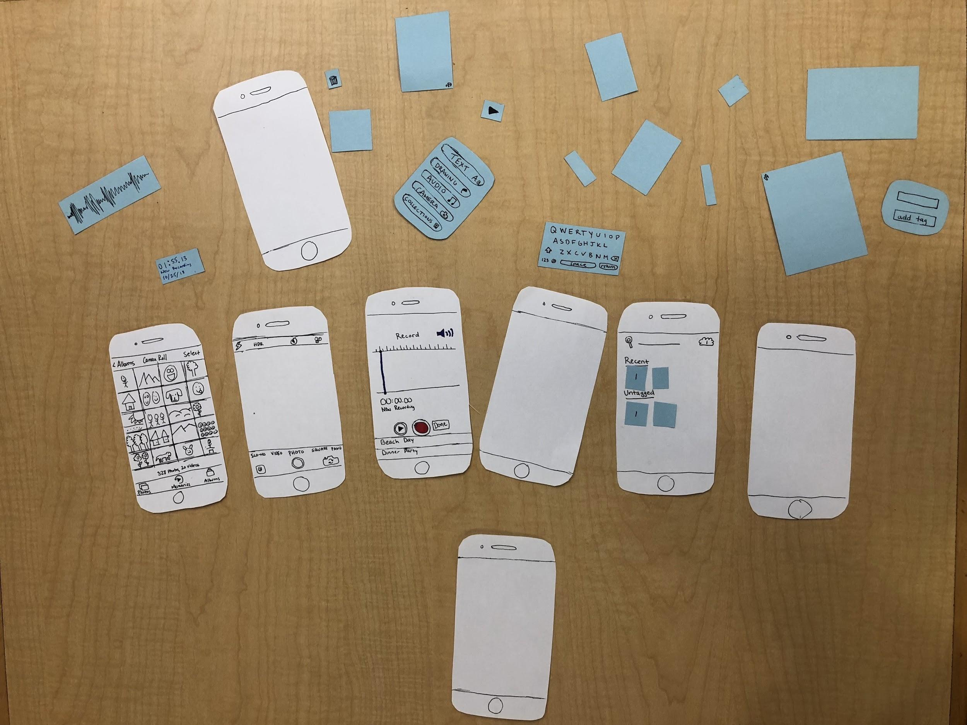
Notes:
And so here is a quick picture of the components constituting our prototype. As you can see, there are several bits and pieces to choose from, where the blue represent the elements which can be added, rearranged, and deleted on a given screen. The functionality of our prototype will be made more clear as I walk you guys through our task flows, which I plan to do next.

Slide 9
Task Flows
Notes:
So for our task flow, we started off with our simple task which was

Slide 10
Simple Task
Creating mementos at the time of/day of
Notes:
To create mementos at the time or day of. And because our simple task is so central to our app experience, we really tried to make it as intuitive and easy to understand as possible. Using the 80/20 rule, we tried to infer what 20% of the user’s actions/gestures would result in 80% of the output within the app, and this is the workflow that we came up with

Slide 11
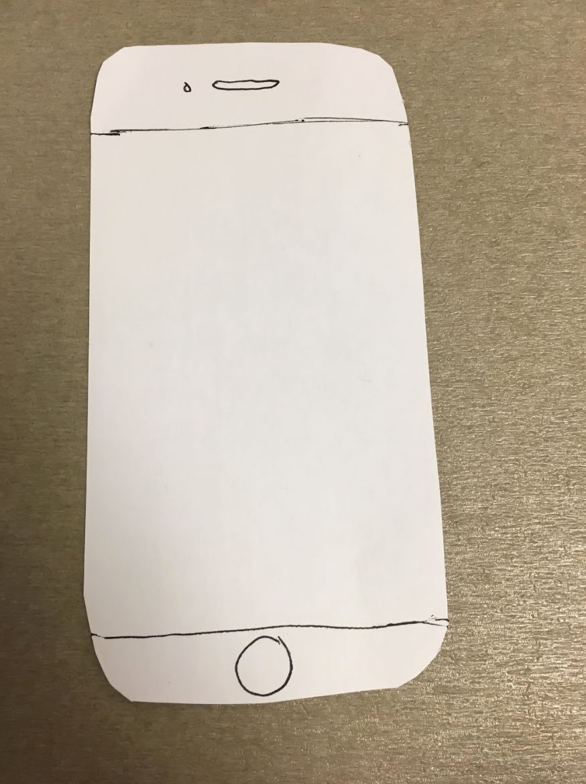
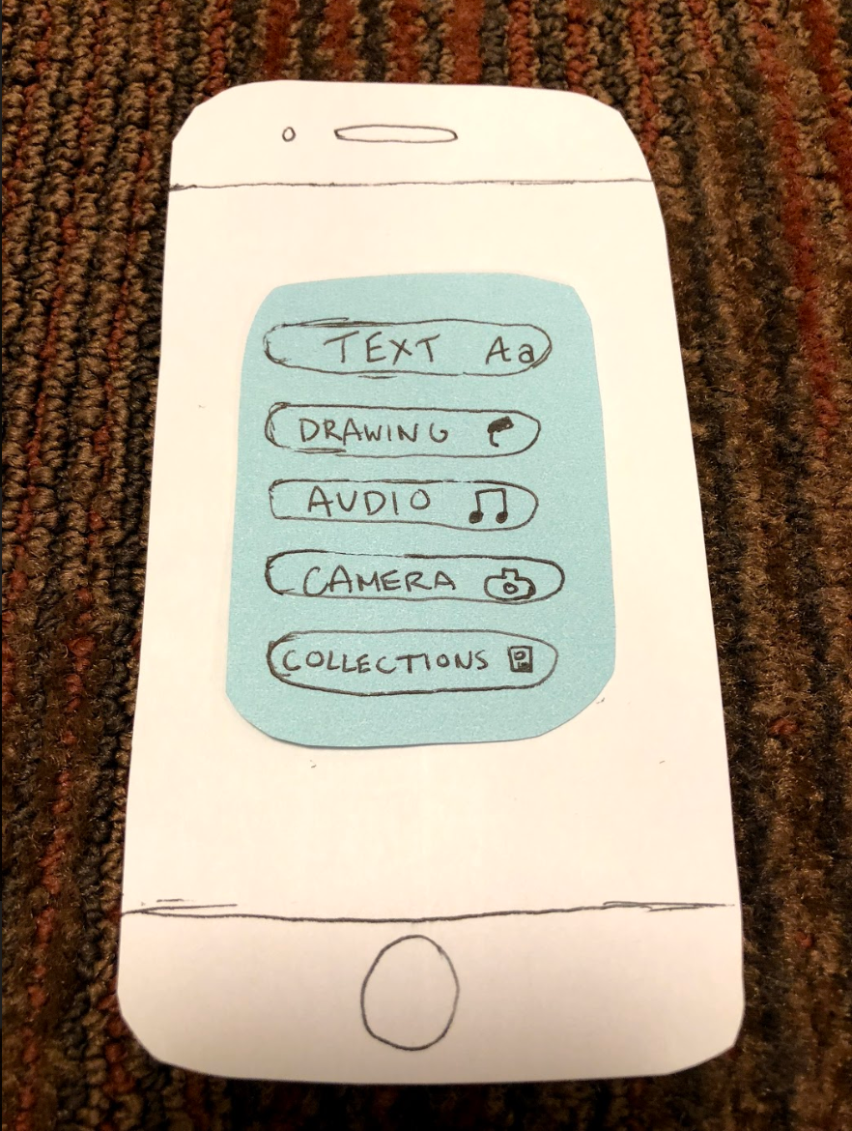
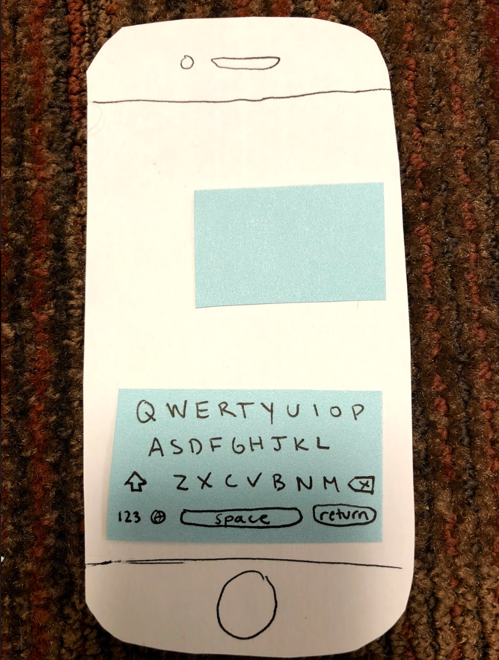
Landing Screen
Menu
Adding a Medium
Task 1: Creating Memories at the time of/day of
Notes:
So walking you through our first task, the user arrives at the landing screen which is just a blank slate. If they tap and hold anywhere on the screen, the menu pops up which has the options of text, drawing, audio, camera as well as collection to showcase their collection of memories. Say that the user taps on text, then they can immediately start typing as showcased here. Once they are down typing

Slide 12
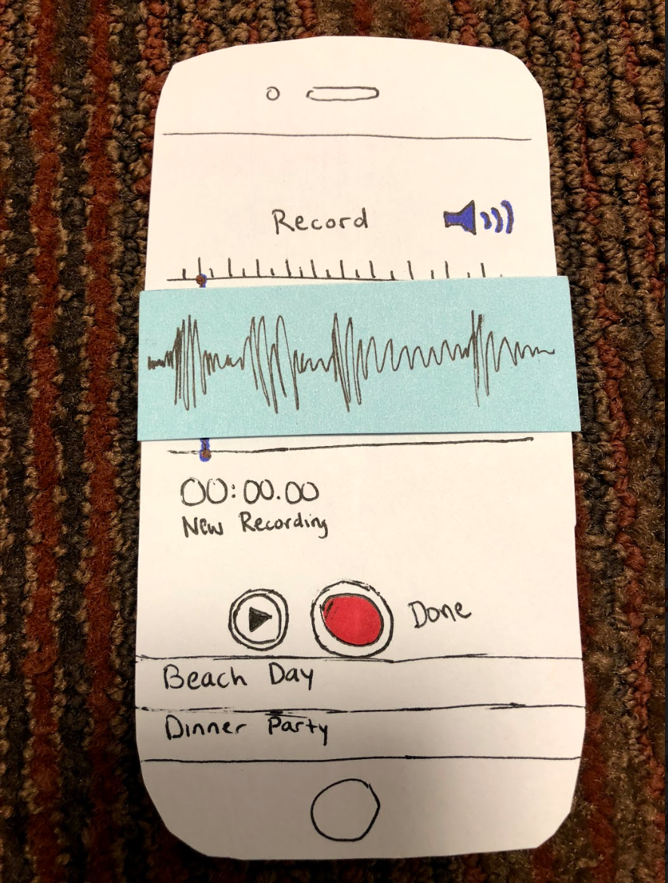
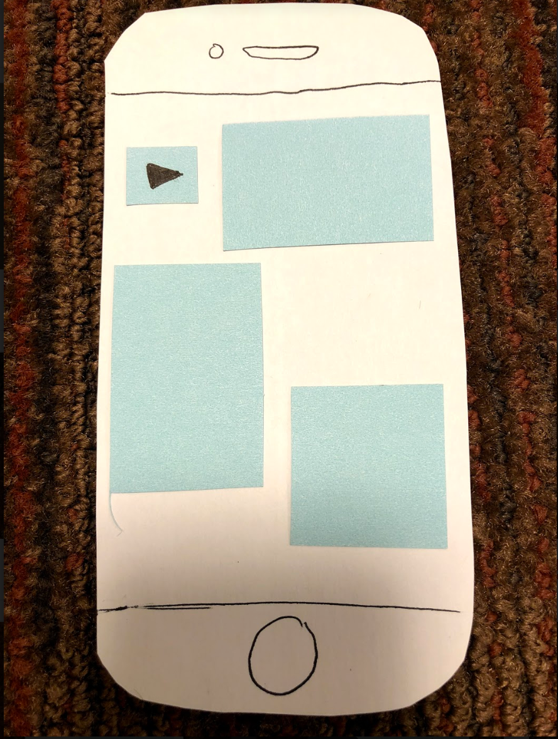
Menu
Adding a Medium
Working Collection
Task 1: Creating Memories at the time of/day of
Notes:
They can press and hold again on the screen to pull up the menu. Now, let’s say the user wants to record, they can do so via pressing on audio and then press down to showcase the audio recording on the canvas.

Slide 13
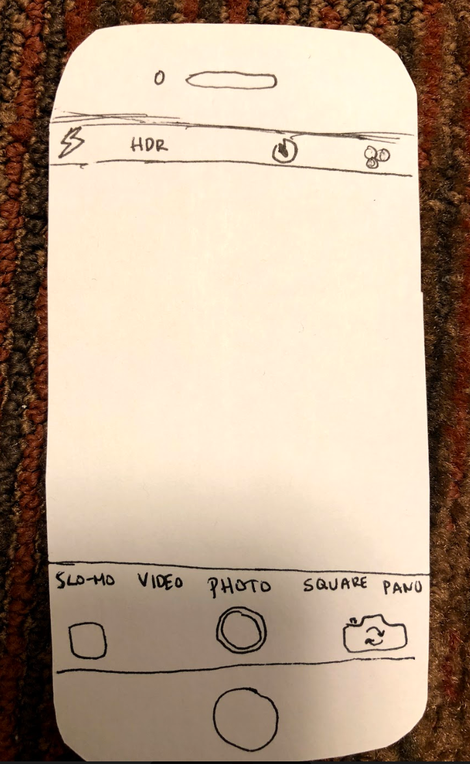
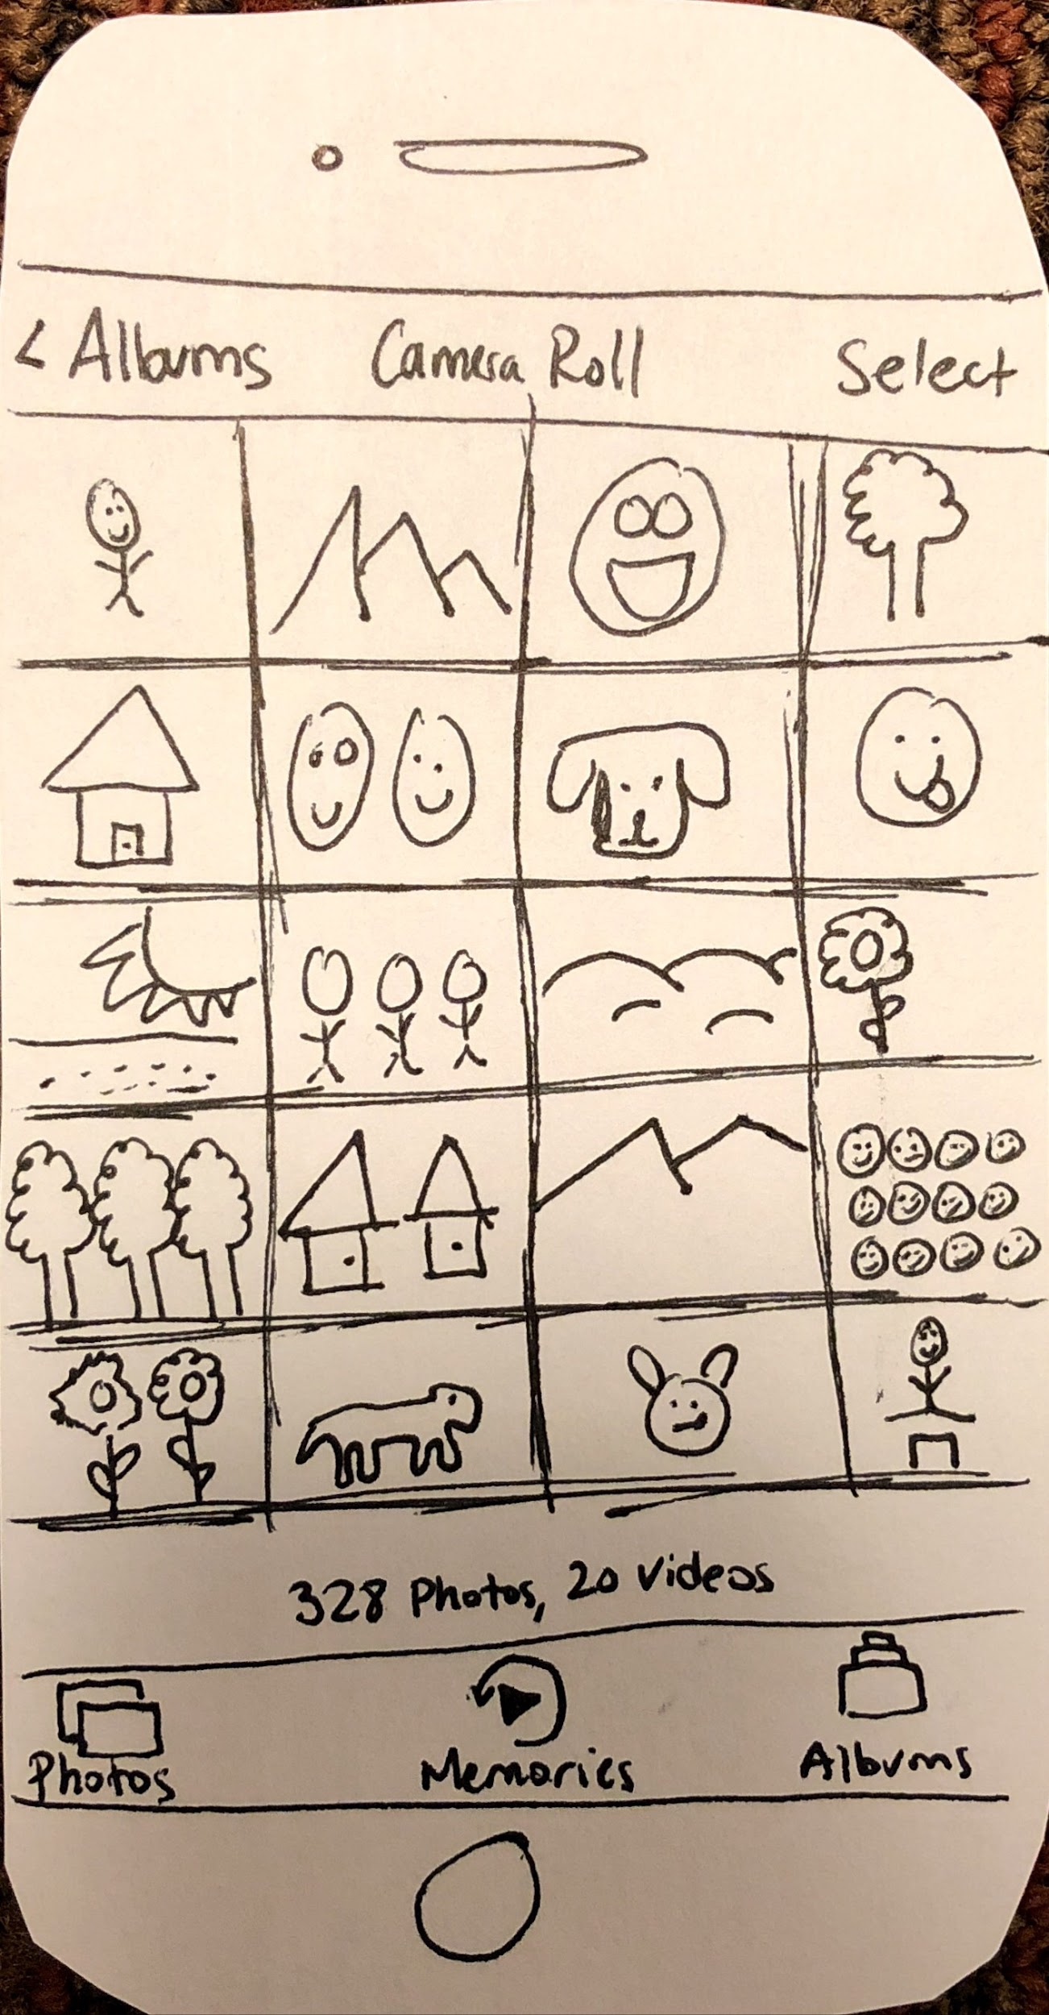
Menu
Taking a Photo
Selecting a Photo
Task 1: Creating Memories at the time of/day of
Notes:
Then they can simply press and hold to access the menu again, this time clicking on the camera to take a photo, then select a photo from their photo album before

Slide 14
Working Collection
Task 1: Creating Memories at the time of/day of
Notes:
Finally “finishing” their working multimodal collection.
So note how everything was just one gesture away, accessible from a central menu.

Slide 15
Moderate Task
Reflecting about specific memories
Notes:
Our moderate task, on the other hand, is about reflecting on specific memories, that is adding, editing, or deleting portions of a given blank slate so

Slide 16
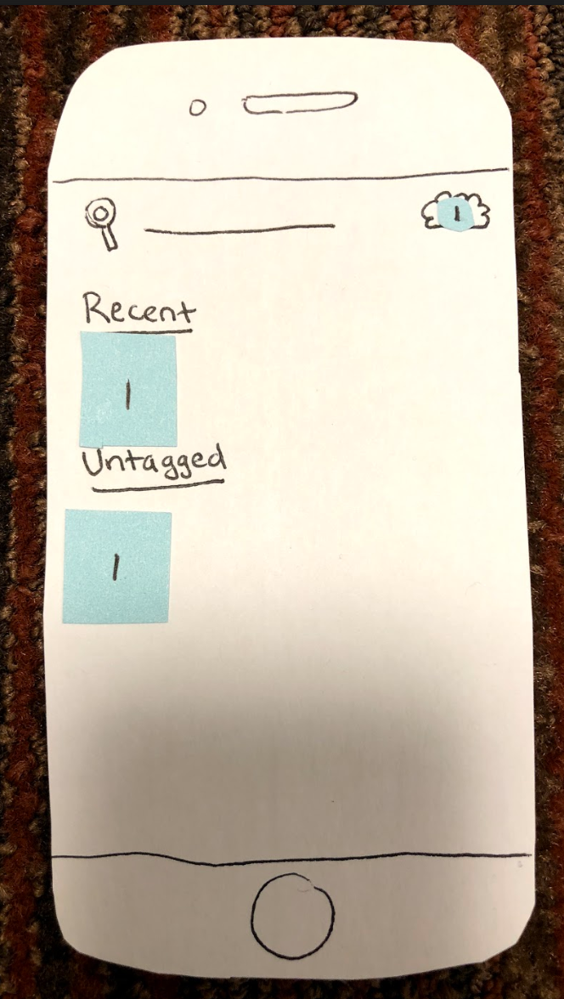
Landing Screen
Menu
Accessing Collection
Task 2: Reflecting about specific memories
Notes:
In this flow we once again land on the landing screen (i.e. blank slate) where the user must press and hold for the menu. To access their collection, they must simply swipe right where they have their collection of memories. It’s important to note how our collection archive is arranged where each square is a thumbnail of a created memory and the most recent memories show up at the top. We also include a streak in our collection area to incorporate that aspect of consistency. But once in this collection archive, all the user has to do is simply tap the desired memory and

Slide 17
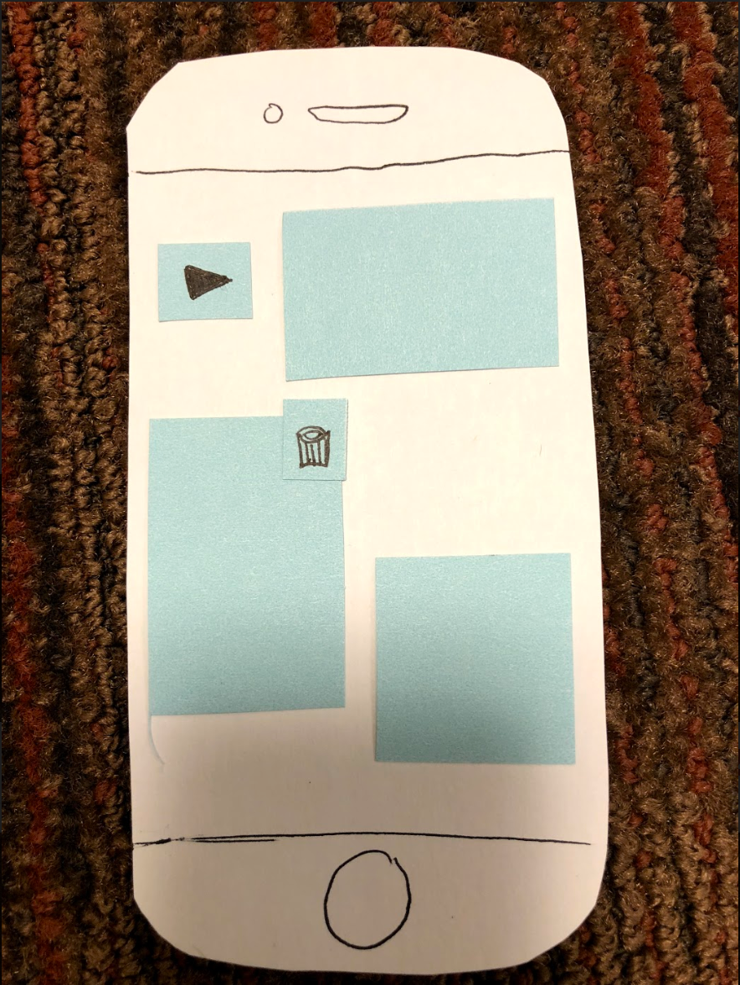
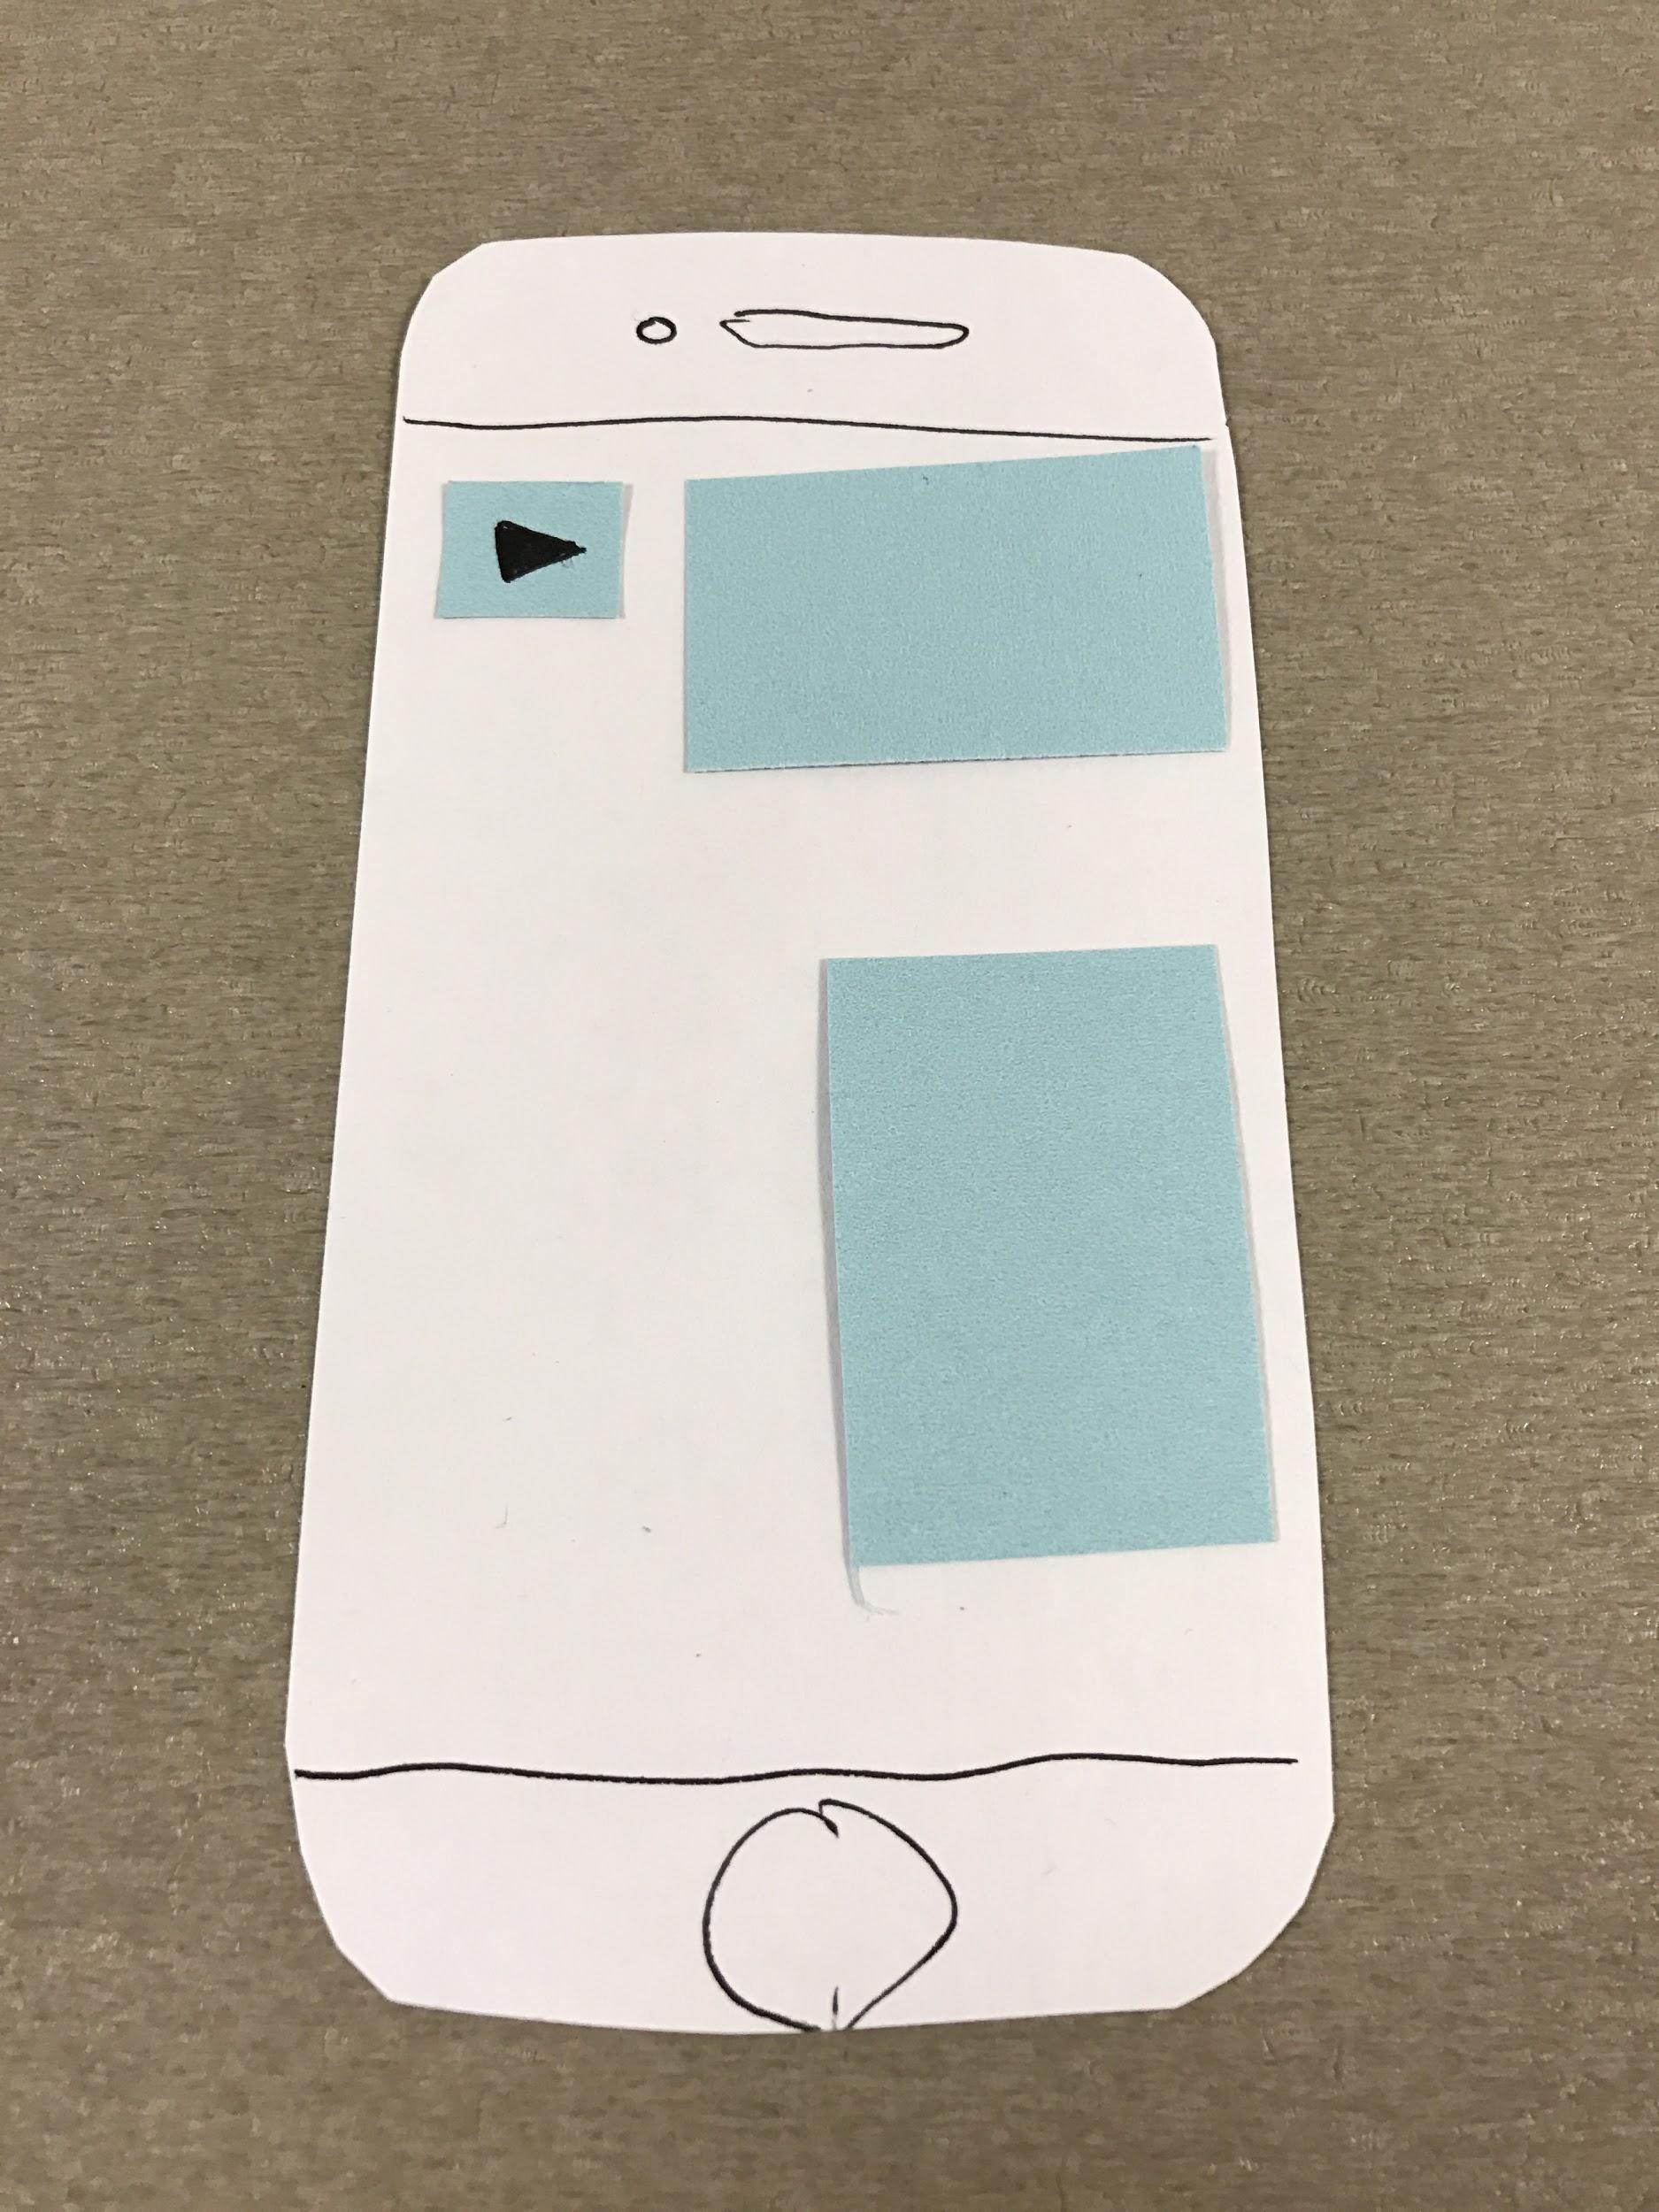
Blank Slate
Editing
Edited Blank Slate
Task 2: Reflecting about specific memories
Notes:
Then they back in that specific blank slate. Now here, they can press and hold on any given part of the memory to edit, add, or delete, with this example arbitrarily showing the user deleting a picture.
So here you can see the differences in pressured touch that we provide. The nuance is that a simple tap does . . . whereas a press-and-hold action pulls up the option of deleting.

Slide 18
Complex Task
Mapping mementos by creating relational associations
Notes:
Now for our last task, we sought to allow the user to map mementos by creating relational associations. In short, we want to help the user organize their collection of memories.

Slide 19
Landing Screen
Menu
Task 3: Mapping mementos by creating relational associations
Notes:
So in order to do that, we once again start on our landing screen where the user can tap and hold to pull up the memory. Here they can simply tap on collection

Slide 20
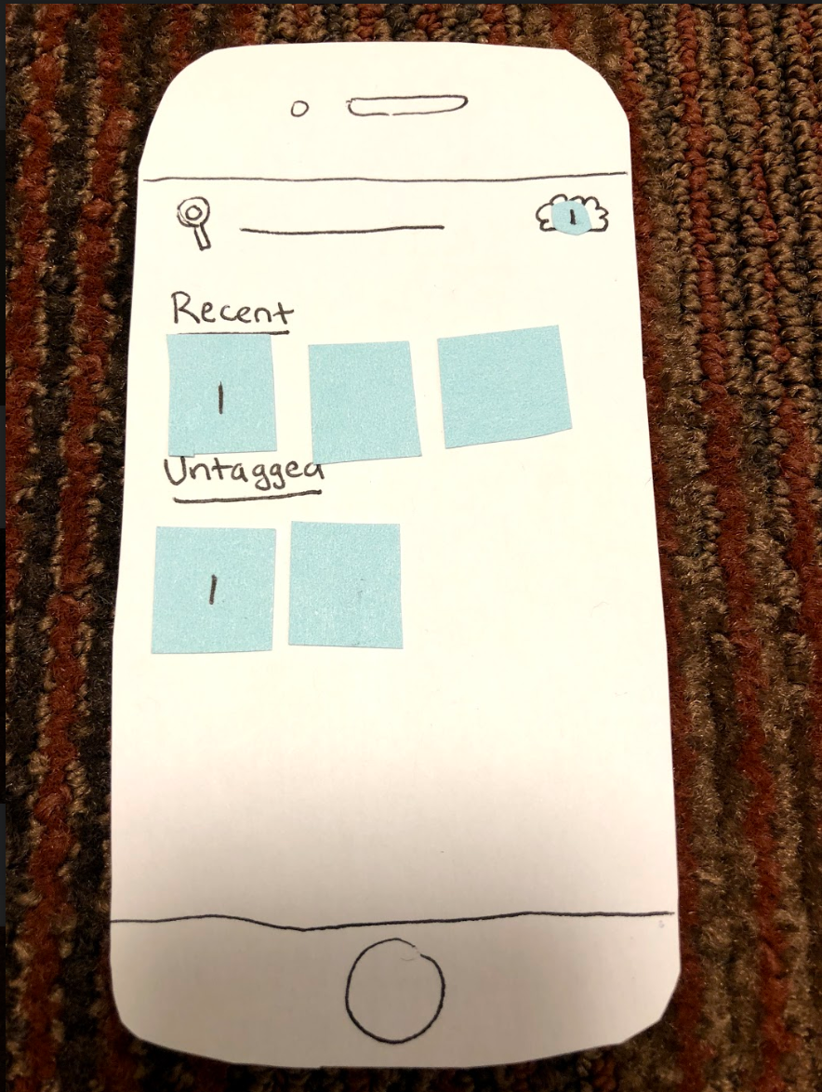
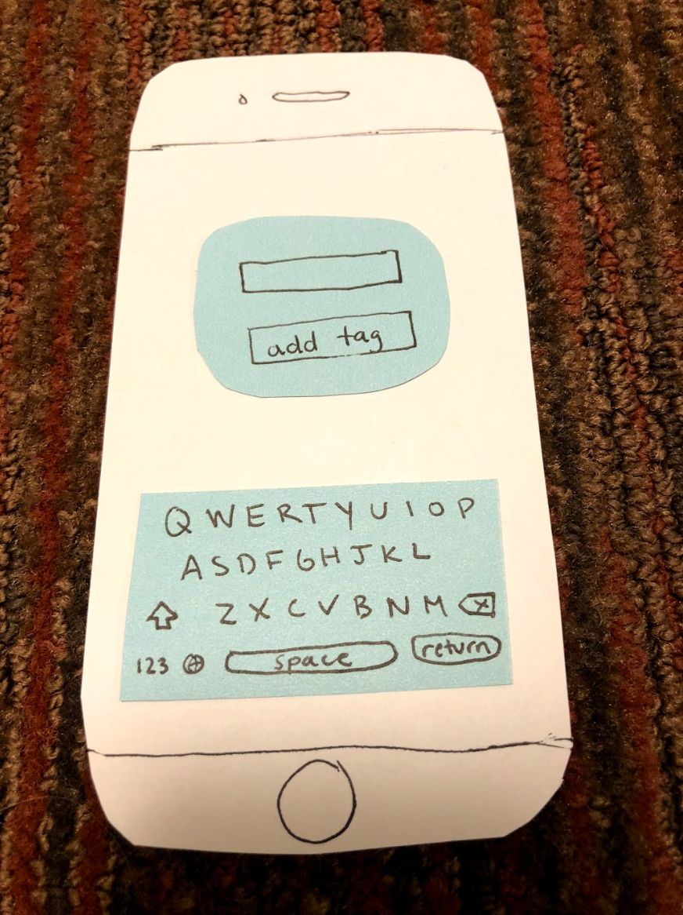
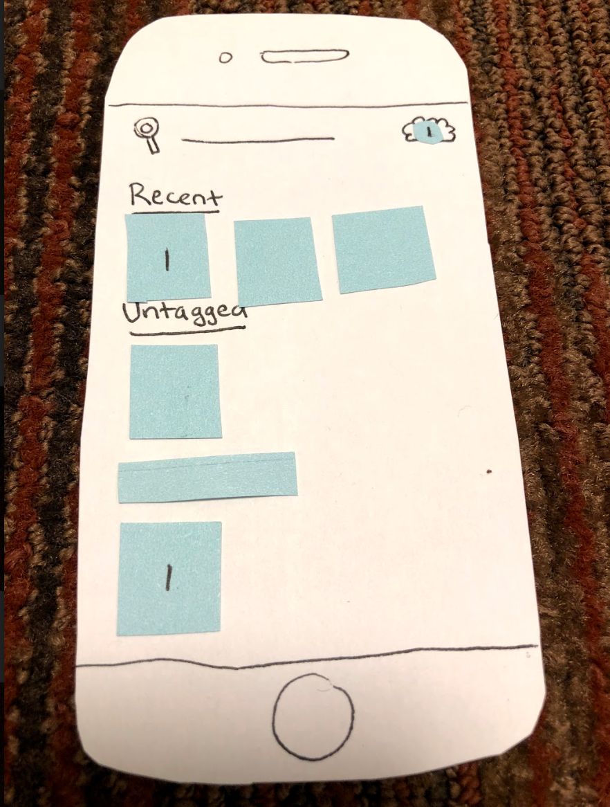
Collection
Adding a Label
Labeled Collection
Task 3: Mapping mementos by creating relational associations
Notes:
To arrive back at their collection archive. And here, they can simply tap and hold to add a tag to a given memory. Afterwards, the memory will be showcased under that labeled tag.
So those were our working task flows which we used during our experimental methods.

Slide 21
Experimental Methods
Notes:
As for our experimental methods,

Slide 22


Participants:
A global citizen man in his thirties and has a preference for recording memories using audio
A 65-year-old Caucasian man who is visiting Stanford on a business trip
A Hispanic Stanford Student in her freshman year
Notes:
We were able to get three participants, the first one being a global citizen in his thirties that has a preference for recording memories using audio, a 65-year older businessman, and a Hispanic Stanford student in her freshman year.

Slide 23
Environmental Set-Up
Location: Tresidder
Initial high-level overview of basic functionality
Had each participant attempt simple, moderate, and complex tasks
Measured successes and severity of incidences
Notes:
Our environmental setup included interviewing these individuals at Tresidder. And we framed our experiments so that we started out with a high level overview of the basic functionality of what our prototype (for instance the difference between a tap and a hold to select an option or pull up the menu) and then we measure the successes and severity of incidences

Slide 24
Experimental Results
Notes:
And these are the results we found

Slide 25
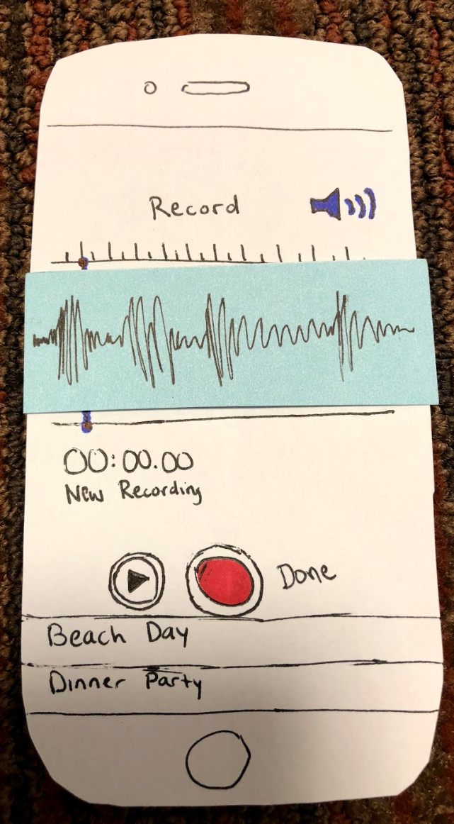
Task One
Successes
Users easily created multimodal memories
Rapid onboarding to central gestures (i.e. hold mechanism for pulling up main menu)
Incidences
Adding audio took very long
Confusion upon saving a memory
Unclear how to zoom out on the blank slate
Notes:
For our first task which is creating memories, we found that users were able to easily create multimodal memories and were quick to find out the core 20% of gestures that encapsulate 80% of our app experience, mainly those corresponding to the menu. Incidences include the fact that the audio took too long, as well as confusion on saving and zooming in on a memory.

Slide 26
Task Two
Successes
Easy navigation to memory editing
Incidences
Lack of “Collections” button use on the menu
Trouble with the ‘hold’ mechanism
Notes:
For our second task, people easily figured out how to edit memories
The downsides were that people didn’t particularly use the Collections button and often had trouble with the ‘hold’ mechanism.
Right balance or that Goldlilocks zone

Slide 27
Task Three
Organizing/labeling was “enjoyable”
Successes
Incidences
Tagging mechanism confusing
Holding down thumbnail unintuitive
Hit “add tag” without typing anything
Notes:
And for task three or organizing memories, we had extreme success with organizing/labeling. We even had one interviewee verbally say “Oh, I like it.” when we were interviewing him which is a good sign.
Incidences include how tagging and holding down the thumbnail can be kind of confusing. And oftentimes people wanted to just add a tag they already created w/o typing anything which our prototype didn’t provide.

Slide 28
Changes for Next Iteration
Notes:
So in terms of what we can change for our next iteration,

Slide 29
For the Creation Experience
Add stretch and remove icons
Pressing media brings it to the front
Add media partly offscreen to show infinite space
For the Editing Experience
Enable memory export and deletion
For the Organizing Experience
Add more ways to tag
Make “return” key work for adding tags in pop up
Notes:
We decided to break this down based on our tasks,
For the creation experience . . . .
We wanted to provide more flexibility in creating, which includes . . .
For the editing experience . . .
We wanted to enable memory export so that people can share with other platforms or their close family or friends as well as deletion
Finally, for organizing, we just wanted to refine the tagging experience where we . . .

Slide 30
Summary
Notes:
So in summary

Slide 31
Users found our simple task (the crux of our product) intuitive to understand
Main Issues:
Some gestures are confusing (holding mechanism)
Tagging should include more options
Future Steps:
Re-evaluate certain key gestures
Creating a minimalist teaching UI
Notes:
. . .

Slide 32
Thank you

